Slide 1

KAVIKULGURU INSTITUTE OF TECHNOLOGY AND SCIENCE RAMTEK-441106
DEPARTMENT OF COMPUTER TECHNOLOGY
TEAM MEMBERS
Under the guidance of Mr. Gaurav Divtelwar Assistant Professor
Mr. Sushant Buche (CT19048)
Mr. Prathamesh Misal (CTD19100)
Mr. Sahil Halmare (CT19010)
Mr. Shubham Kukwas (CT13044)
Ms. Samiksha Sonkusare (CT19024)
Ms. Madhuri Bhoyar (CTT19114)

Slide 2

ENHANCING THE LOGISTICS SYSTEM'S PRIVACY AND TRACEABILITY USING BLOCKCHAIN

Slide 3

CONTENTS
Introduction
Aims and Objective
Literature Review
Proposed Approach and System Architecture
Implementation Work
Results and Discussions
Conclusion and Future Scope
References

Slide 4
INTRODUCTION
In recent years,the rapid changes in the internet industry have made logistics management more and more informational behind this trend, there are many problems that need to be solved.
There are many areas and long time spans in logistics links, so supervision is difficult, and counterfeiting is difficult to eradicate. To solve this problems we use block chain technology, the logistics blockchain is formed through data encryption and consensus verification, there by ensuring the authenticity and transparency of logistics service transaction information, and ensuring that the information will not be tampered with and can be queried and traced to the source.
Blockchain technology effectively solves the pain points of traditional traceability systems by using its technical features. The types of blockchains can be divided into public chains, consortium chains, and private chains according to the characteristics of their members.

Slide 5
AIM
The aim of this process is to solve the problems of inefficiency, key abuse and inflexibility of access control policy for data privacy protection and sharing based on block chain.

Slide 6
PROJECT OBJECTIVE
To develop output design that serves the intended purpose and eliminates the production of unwanted output.
To develop the output design that meets the end user’s requirements.
To deliver the appropriate quantity of output.
To form the output in appropriate format and direct it to the right person.
To make the output available on time for making good decisions.

Slide 7
Outcomes
LITREATURE REVIEW
Authors
Title
A controllable sharing model for electronic health records based on blockchain
,IEEE, 2020
Data masking technology and Inter Planetary File System (IPFS) are introduced to build a safe and efficient electronic medical record sharing model based on blockchain.
L. Zhang, Z. Y. Zheng, and Y. Yuan
Electronic medical record
S. F. Niu, W. K. Liu, and L. X. Cheng
data sharing scheme based
They use proxy re-encryption (PRE) technology to enable third-party data users to securely access patient data.
on searchable encryption via consortium blockchain
,IEEE, 2020

Slide 8
Authors
Title
Outcomes
This paper combines hierarchical attribute encryption with linear secret sharing, and proposes a blockchain data privacy protection control scheme based on searchable attribute encryption, which solves the privacy exposure problem in traditional blockchain transactions
Blockchain data privacy protection mechanism based on searchable encryption
,2019 Artical
L. G. CH and Q. LI
Aiming at the poor stability of traditional communication data encryption
Research on point-to-point encryption method of power system communication data based on block chain technology
,IEEE Transaction, 2019
methods, a point-to-point encryption method of power system
H. Qin, Z. Li, P. Hu, Y. Zhang, and Y. Dai
communication data based on block chain technology is studied and designed.

Slide 9
PROPOSED APROACH
In proposed system we implement the searchable encryption scheme that can realize keyword search on cipher-text. The basic application process of searchable encryption technology is: the sender encrypts his own data and uploads it to the remote server, and submits its keyword data to the server when it needs to retrieve the file user.

Slide 10

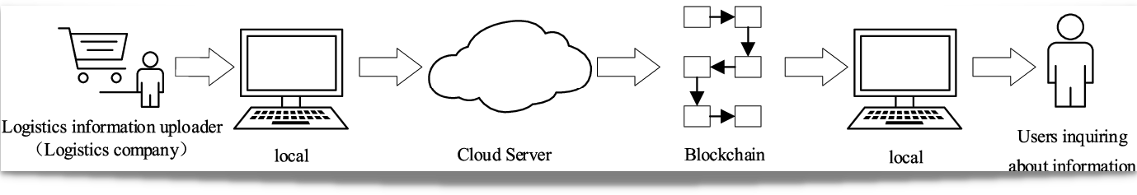

Slide 11
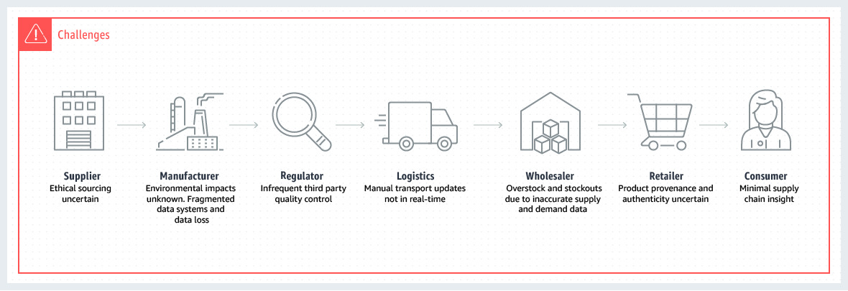
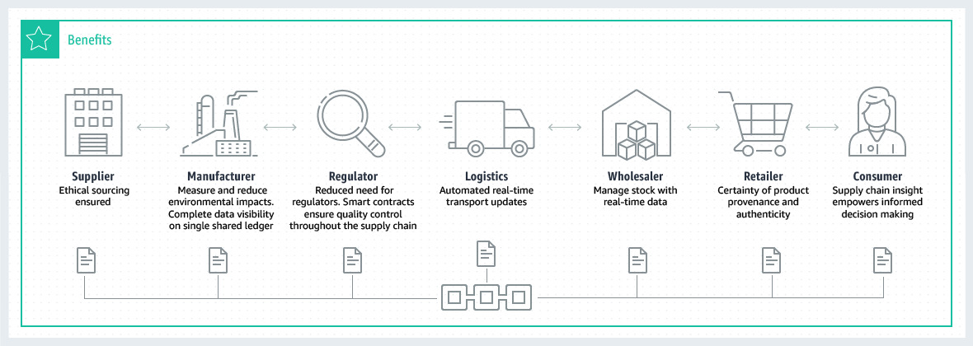

Slide 12
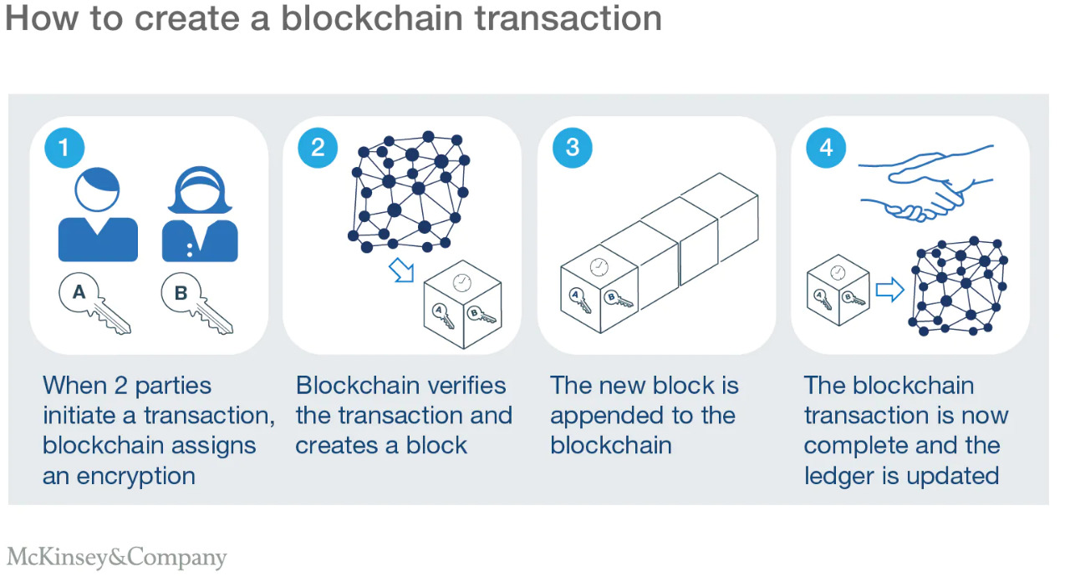

Slide 13
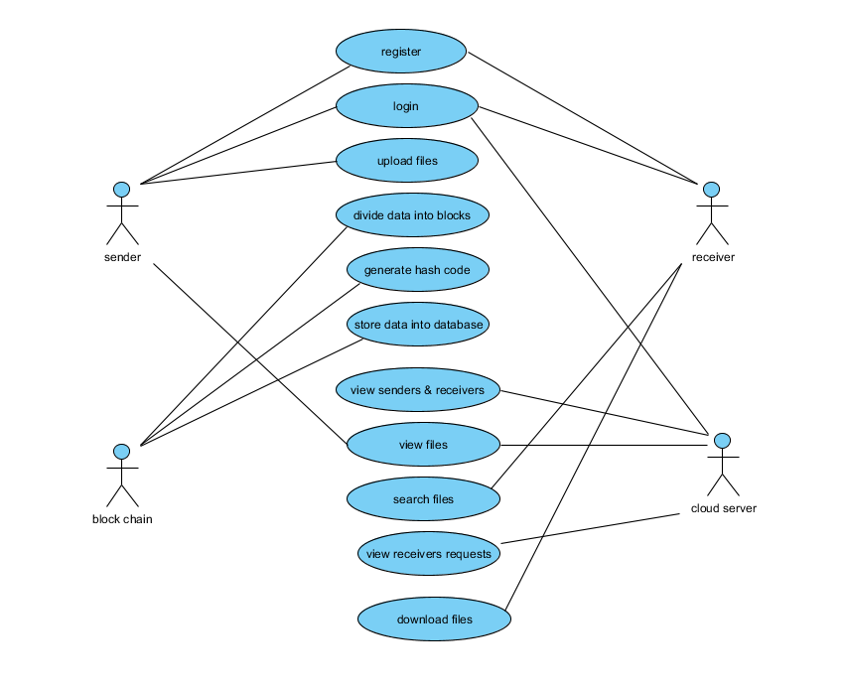

Slide 14
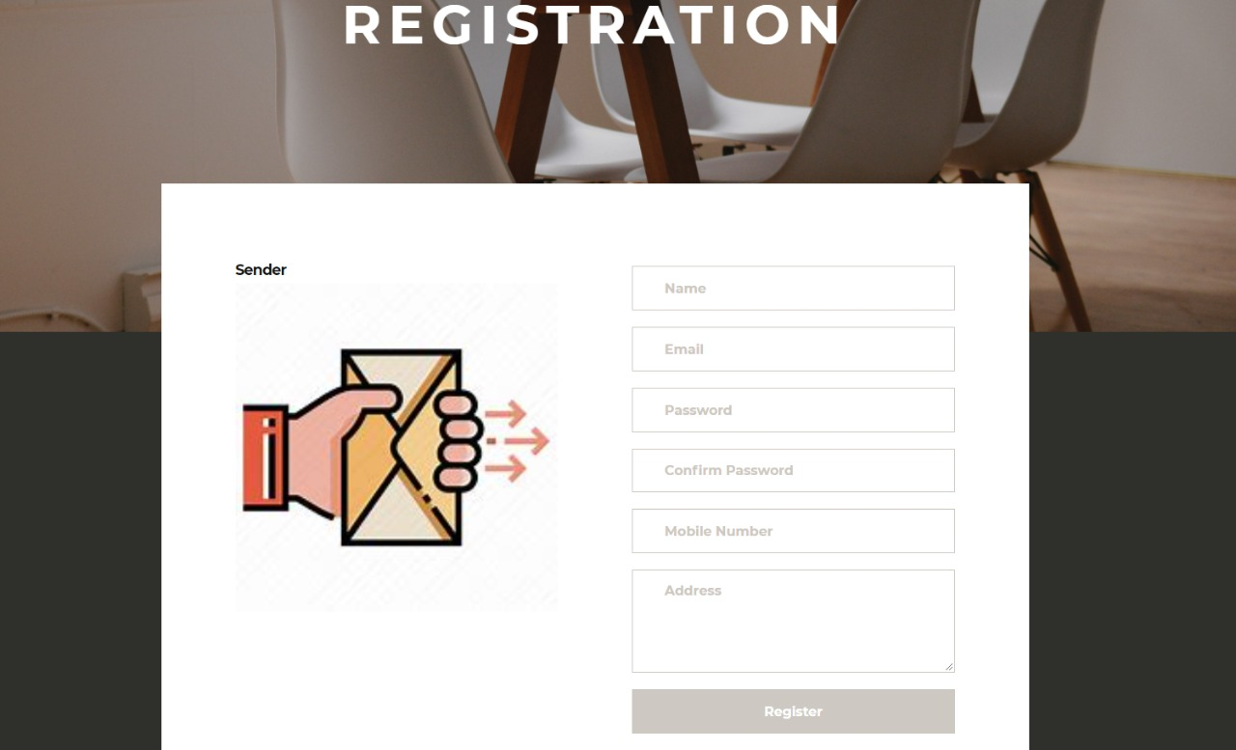

IMPEMENTATIONED WORK
REGISTRATION
LOGIN PAGE

Slide 15
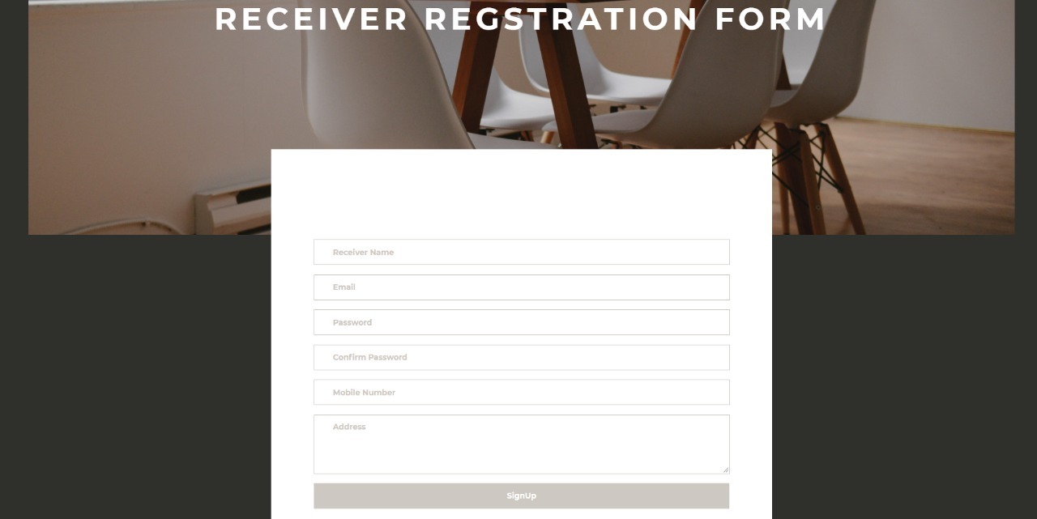
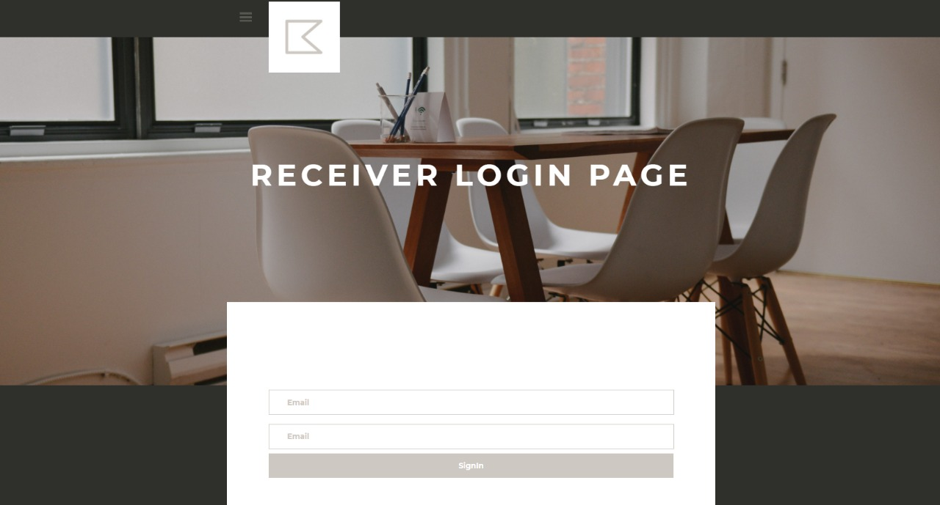
RECEIVER REGISTRATION FORM
RECEIVER LOGIN PAGE

Slide 16
RESULTS AND DISCUSSIONS
S.NO | Test cases | I/O | Expected O/T | Actual O/T | P/F
1 | Upload text file | Text file path. | Store files in to database successfully. | File uploaded successfully | P
2 | Login | Enter valid email ,password and secret key | Login to the Userhome page successfully | Login to the Userhome page successfully | P
3 | Login | Enter invalid email or password or secret key | Invalid credentials login failed | Login failed | F
4 | Request file | Provide acceptance | If cloud accepts the request, user get a key through mail successfully | Successfully receive the key | F
5 | Download file | Enter valid decrypted key | File downloaded successfully | File downloaded successfully | F
6 | Download file | Invalid decrypted key | File not downloaded | File not downloaded | F

Slide 17
CONCLUSION
In response to the current demand for logistics information at any time, In order to ensure the reliability and privacy of information, combining the advantages and characteristics of blockchain technology, and using searchable encryption to encrypt and decrypt data, a logistics information blockchain data query algorithm based on searchable encryption is proposed. The algorithm first encrypts the information, the encrypted information is stored in the cloud server, and an index list is generated for each group of information, and keywords can be used to query the corresponding information. the process of encryption and decryption as well as the process of data insertion and data query are designed in detail. Finally, the solution of this project is analyzed from three aspects of correctness, completeness and security, which proves the feasibility of the algorithm of this project.

Slide 18
FUTURE SCOPE
The next research direction is to conduct in-depth research on the smart contract technology in the algorithm to better improve query efficiency.

Slide 19
REFERENCES
HTTPS://WWW.RESEARCHGATE.NET/PUBLICATION/359021074_A_CONTROLLABLE
_SECURE_BLOCKCHAIN BASED_ELECTRONIC_HEALTHCARE_RECORDS_SHARING_ SCHEME
HTTPS://WWW.RESEARCHGATE.NET/PUBLICATION/345355606_ELECTRONIC_HEA LTH_RECORD_SHARING_SCHEME_WITH_SEARCHABLE_ATTRIBUTE- BASED_ENCRYPTION_ON_BLOCKCHAIN.
L. G. CH AND Q. LI, ‘‘BLOCKCHAIN DATA PRIVACY PROTECTION MECHANISM BASED ON SEARCHABLE ENCRYPTION,’’ COMPUT. APPL., VOL. 39, NO. 2, PP. 140– 146, 2019.
HTTPS://IEEEXPLORE.IEEE.ORG/DOCUMENT/9017047
HTTPS://IEEEXPLORE.IEEE.ORG/DOCUMENT/8718276
HTTPS://IEEEXPLORE.IEEE.ORG/DOCUMENT/8006293
HTTPS://WWW.RESEARCHGATE.NET/PUBLICATION/328491342_BLOCKCHAIN_ARC HITECTURE_AND_RESEARCH _PROGRES

